Slide 1
Introduction

Slide 2
Generalize the design process
Water Source
Possible Unit Processes
Contaminants
Select Unit Processes
Disinfection Complications
Regulations
Sequence the unit processes
Client needs
Distribution Complications

Slide 3
Unit Processes Defined
Unit process? “one or more grouped operations in a manufacturing system that can be defined and separated from others” https://en.wikipedia.org/wiki/Unit_process
Is flocculation a unit process?
Some unit processes only make sense as part of a sequence

Slide 4
Unit Process Cheat Sheet
Required upstream UP
Required downstream UP
Contaminants that must be removed prior to UP to protect the UP from damage
How does it work?
What types of contaminants does it remove
What types of inputs (energy and chemicals) does it requires
What might a cheat sheet look like? Is it a table? Or a flow chart with different entry points

Slide 5
Organize by choice (parallel) and order (series)
Adsorptive Media
Aeration and Air Stripping
Biological Filtration
Biological Treatment
Chemical Treatment
Chloramine
Chlorine
Chlorine Dioxide
Conventional Treatment
Diatomaceous Earth Filtration
Direct Filtration
GAC Isotherm (includes PAC isotherms)
Granular Activated Carbon
Hydrogen Peroxide
Ion Exchange Greensand Filtration
Membrane Filtration Microfiltration and Ultrafiltration
Membrane Separation Nanofiltration, Reverse Osmosis, Electrodialysis, and Electrodialysis Reversal
Other Treatment
Ozone
Ozone + Hydrogen Peroxide
Permanganate
Powdered Activated Carbon
Precipitative Softening
Pressure Filtration Bag Filtration and Cartridge Filtration
Slow Sand Filtration
Ultraviolet Irradiation
Ultraviolet Irradiation + Hydrogen Peroxide
Ultraviolet Irradiation + Ozone
Notes:
https://iaspub.epa.gov/tdb/pages/treatment/findTreatment.do

Slide 6
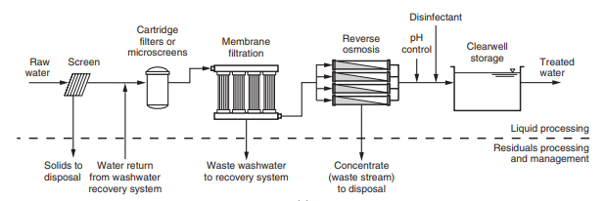
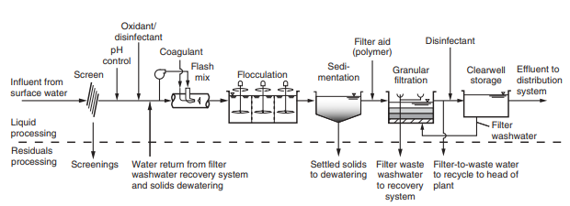
MWH's%20Water%20Treatment.pdf
Must create my own!

